Slide 1

Career Match
“Forget Love Connections, Let’s Make a Career Connection”
Christina Sullivan
Michael Reynoso
Rohan Rao

Slide 2
Idea & Research
Christina Sullivan

Slide 3


Problem
Networking is a stressful & uncomfortable time for many individuals.
Mistakes commonly occur leading bad first impressions & minimal new opportunities.
Individuals may not always have the time to attend networking events.

Slide 4
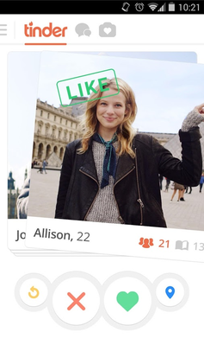
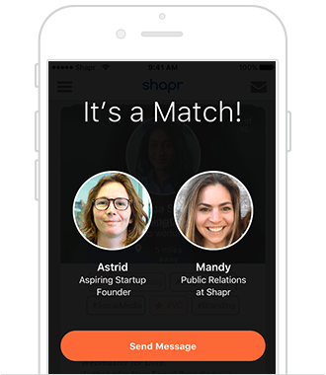
Research
Discover:
Previous solutions to the issue & what issues still arise.
Determine:
Successful software components for popular apps to reuse.
Eliminate:
Previous failed solutions based on customer feedback.
Design:
App requirements & features based on information gathered

Slide 5
Our Solution
Network at the touch of your fingertips to generate relevant employers.
Let your profile speak for you!
Employers can review your profile only if you express interest.
No more profile stalking!
Decrease the time for recruiters to review resumes
Once a match is established, the chat option becomes available to schedule an interview.
Eliminate unwanted solicitation from employers
Connect Online, Meet Offline.

Slide 6
Requirements & Design
Michael Reynoso
Notes:
Explain Architectural Design, Interface Design,

Slide 7
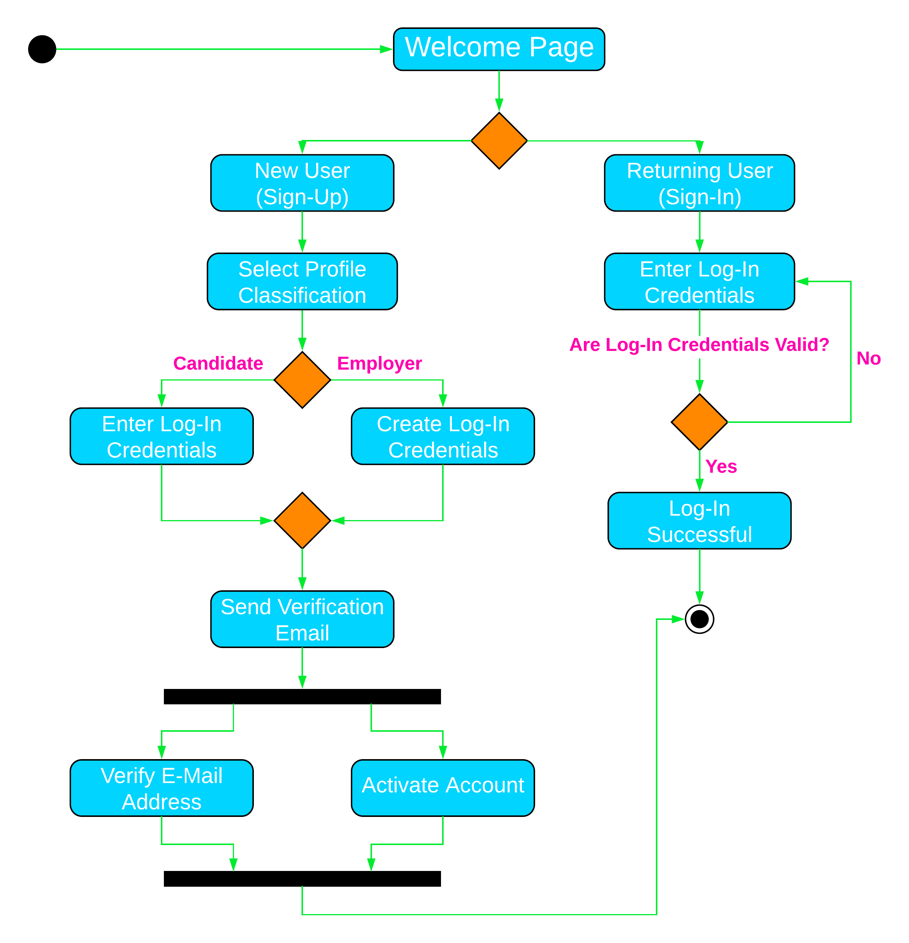
Activity Diagram for Login Page

Slide 8

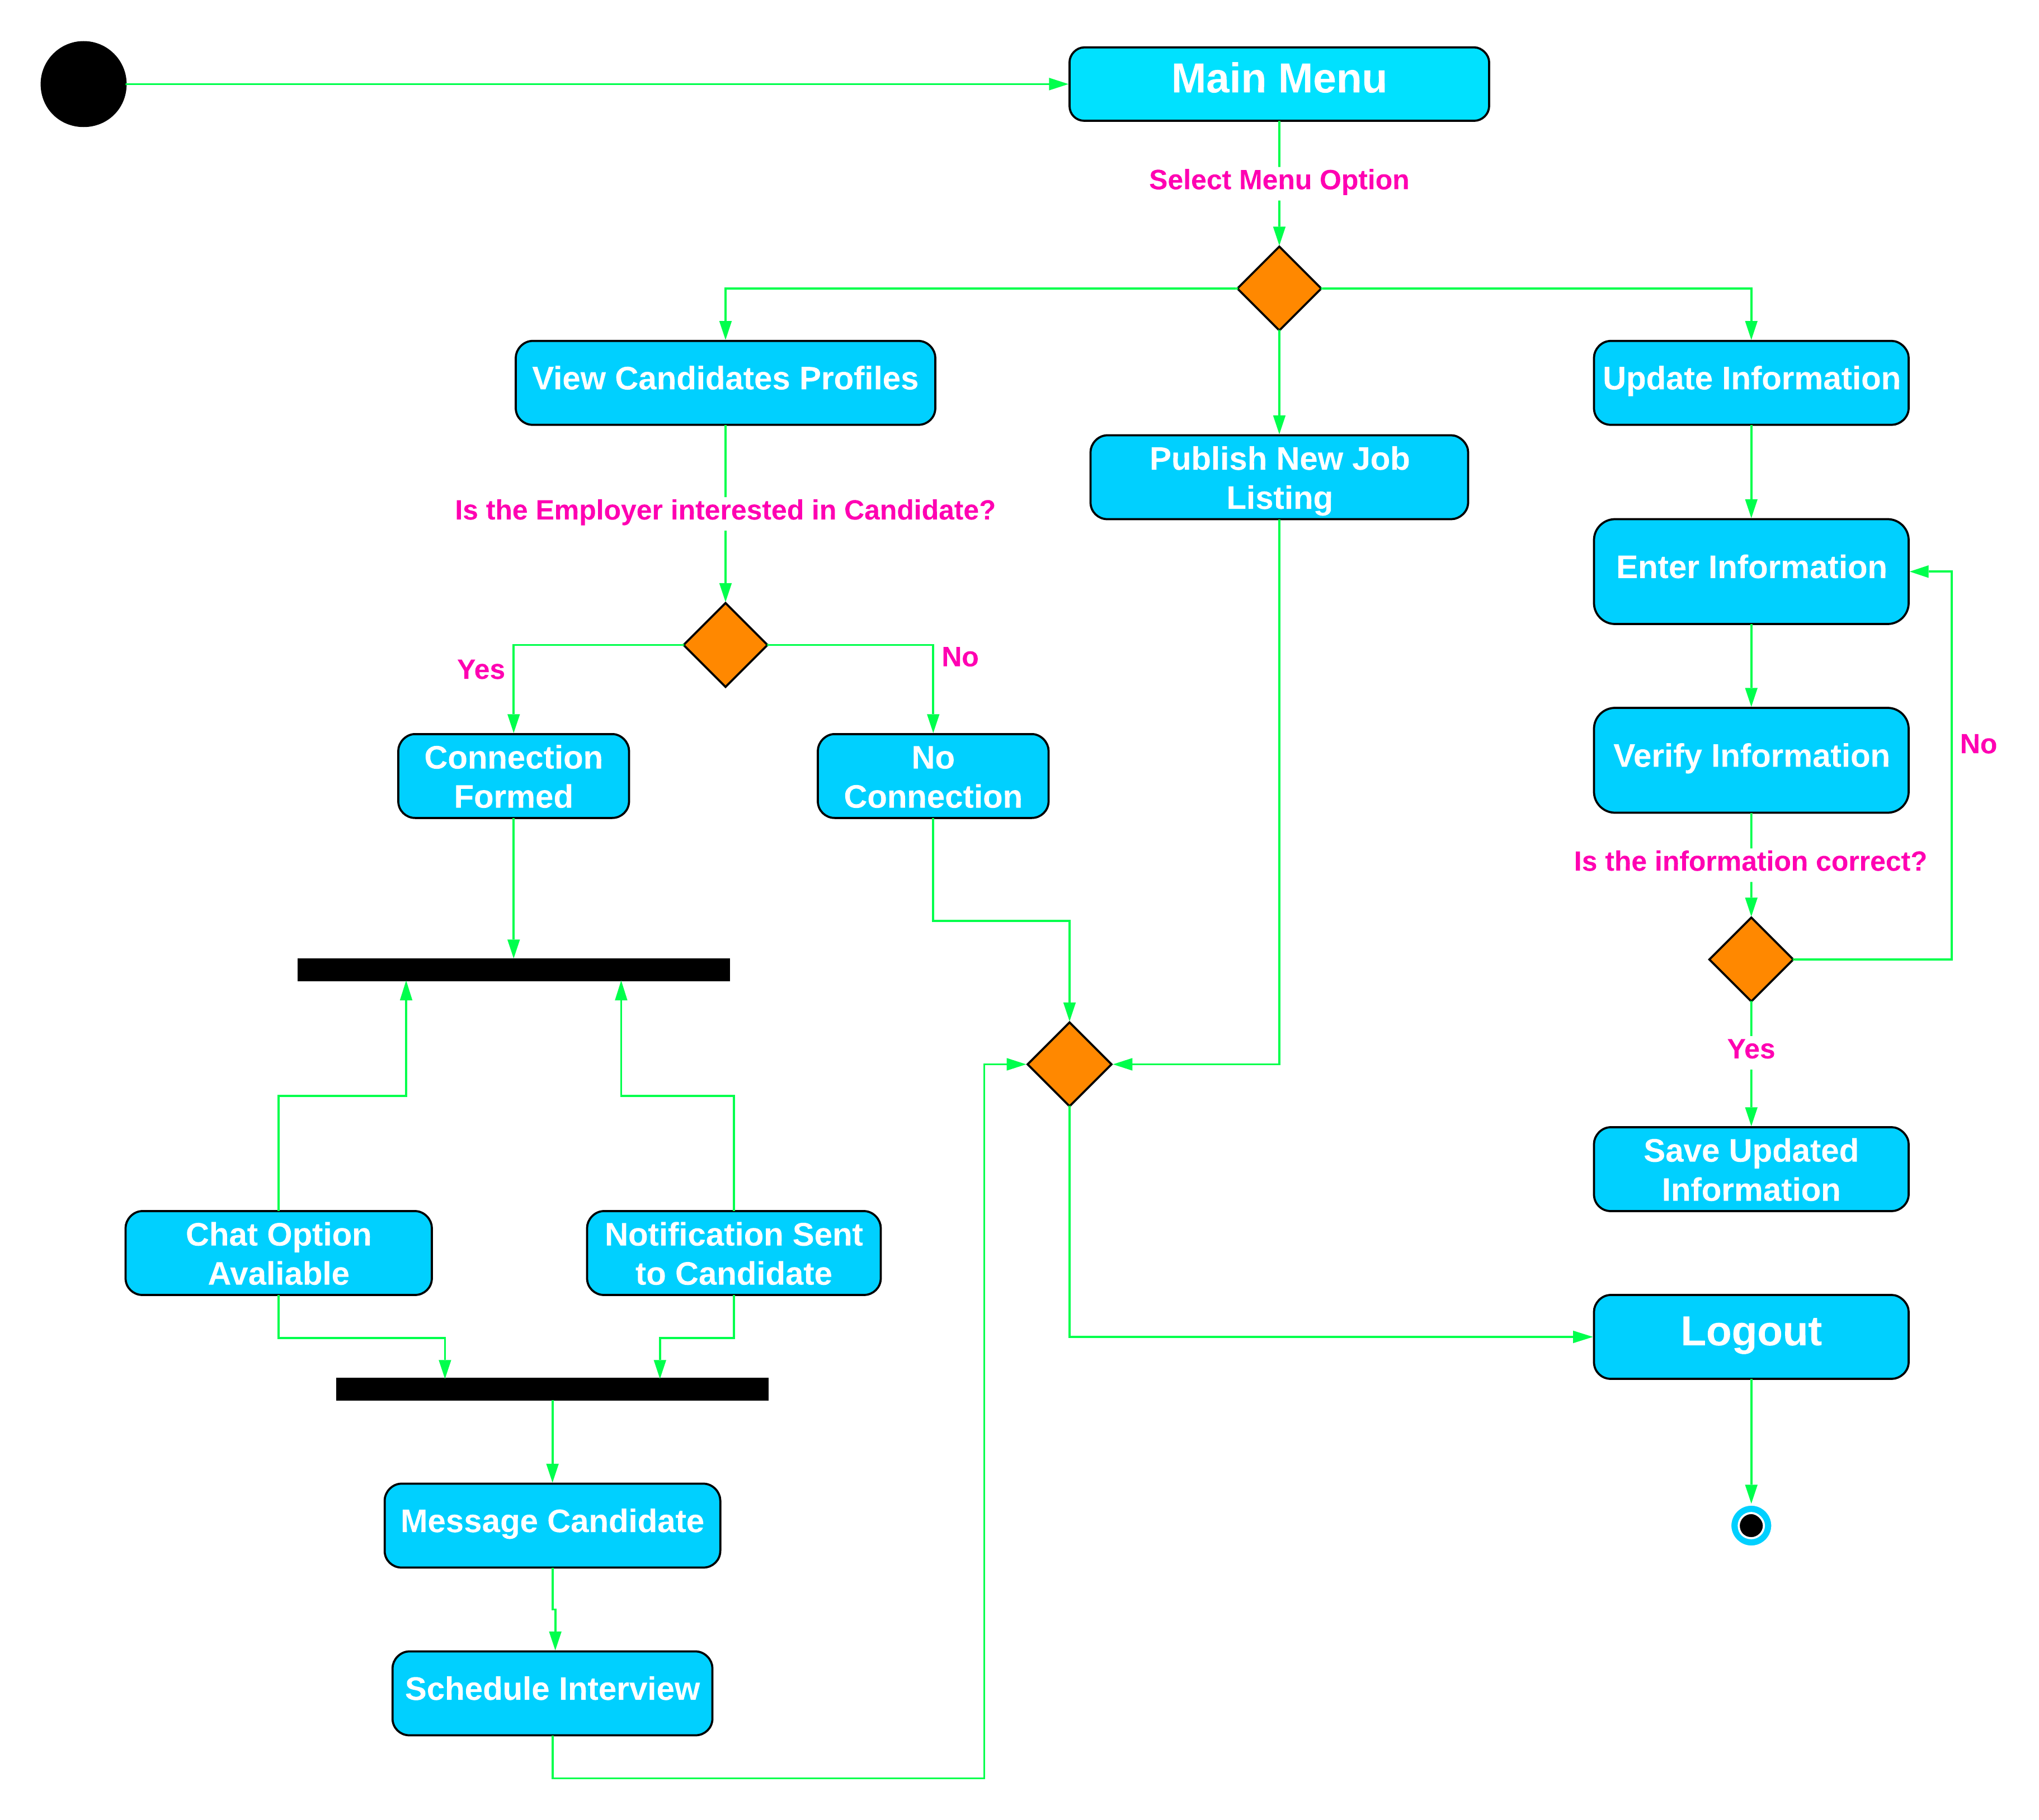
Activity Diagram for Employer Account

Slide 9
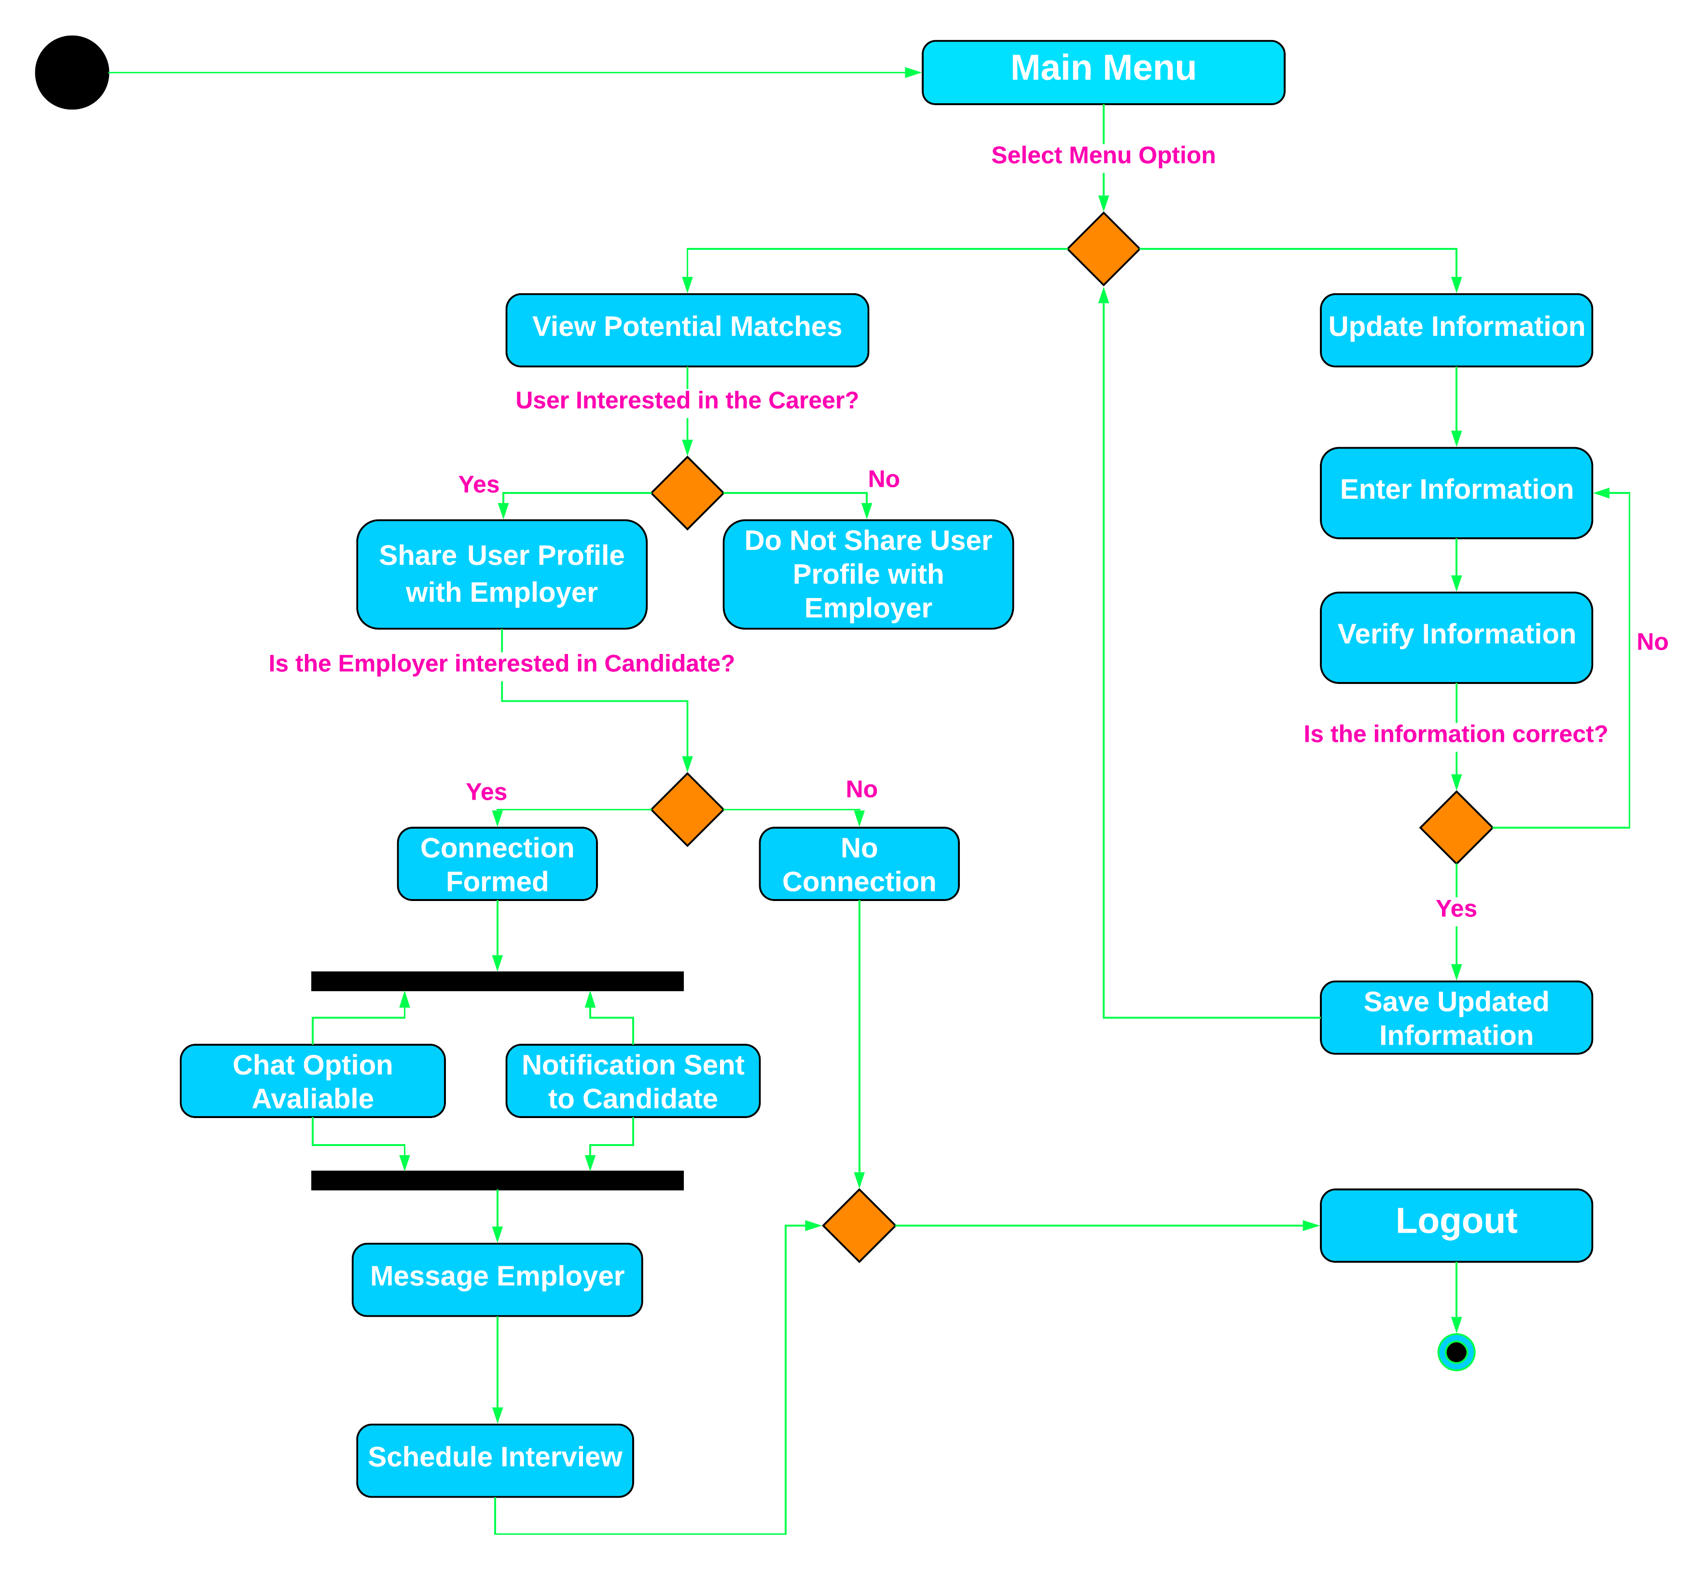
Activity Diagram for Candidate Account

Slide 10
Implementation & Testing
Rohan Rao

